Slide 1
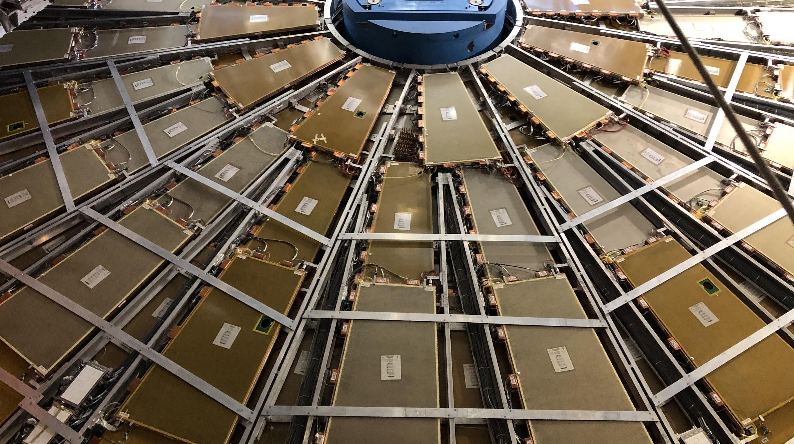

Maintenance Weekly
TileCal Op Meeting, 18 November 2021
Irakli Minashvili, Chris Thomas, Dawit Belayneh, Katie Hughes

Slide 2
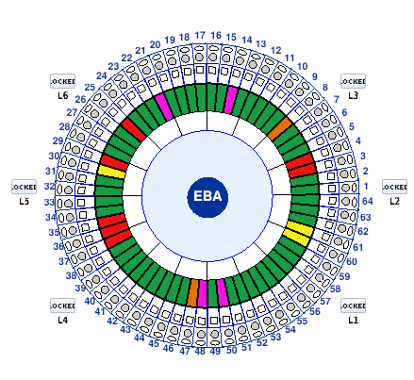
Isolation Valves Update
Still installing on EBA
Green: fully completed!
Yellow: valves mounted but not connected
Red: not started
Pink: Cesium garage blocking installation
Orange: Electronics box blocking installation

